Slide 1


Predict ratings of Sephora website products
Ouykhy Quach
FEB, 11th | PARIS
DAFT NOV21

Slide 2
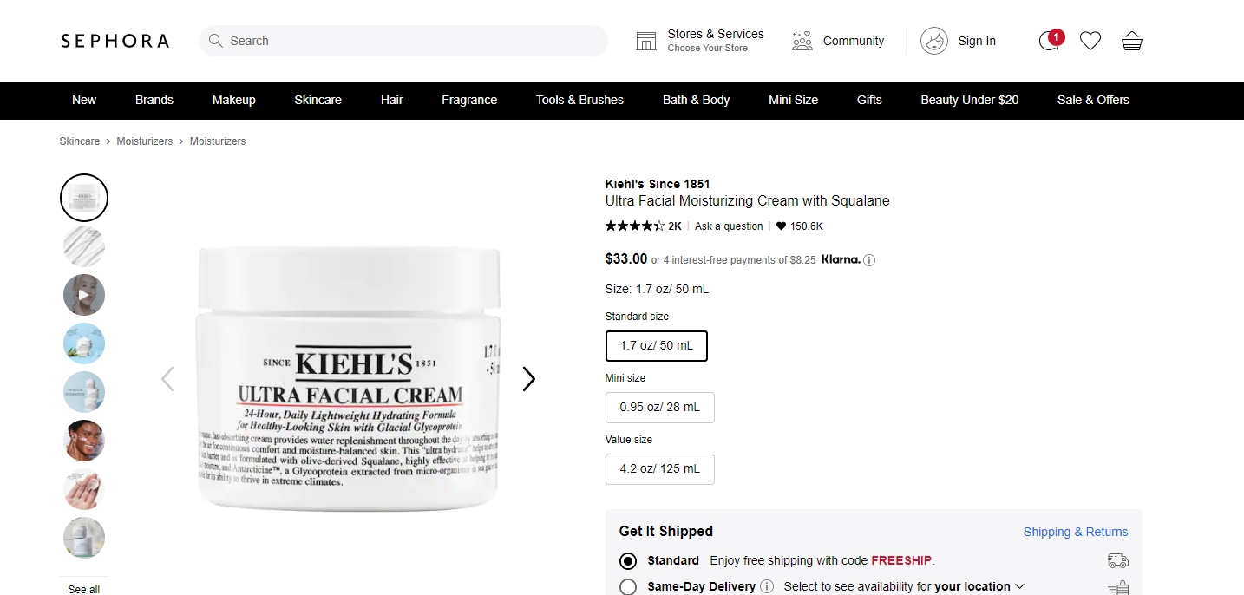

Business case
Customer ratings can impact the customer buying decision
Predicting rating of products and issue recommendations on crucial information will improve the ratings

Slide 3

Plan
Explore and analyse the dataset to draw some initial insights
Leverage supervised machine learning to predict the ratings based on the historical data
Leverage unsupervised ML clustering to group the products based on the available features

Slide 4



Data description
Dataset from April 2020
available on Kaggle
Mix of categorical (14)
and numeric data (7)
Shape: 21 columns and > 9000 rows
Products info include
Brand
Category
details description
how to use guidance
Ingredients
Rating
number of reviews
Love
price

Slide 5




Exploratory data analysis
Target
Influencing
the rating
Not influencing
the rating
Rating column ranging
from 0 to 4.5
Reviews
Love
ingredients list
Price
Size
Specific marketing /Exclusive / online
description of the product (length of details)
instructions (how to use)
Tableau dashboard

Slide 6




Data cleaning / preparation
Dropped 9 columns containing either unique values, redundant or inappropriate info
Encoded the categorical columns values: ‘Category’, ‘Brand’
Transformed the “text” columns values (‘details’ and ‘how to use’) to count the length of strings
‘ingredients’ column was encoded to show known or unknown
The ‘rating’ imbalanced target was transformed with oversample and undersample methods
Rating | Distribution | Count value after balancing
0.0 | 398 | 3527
1.0 | 23 | 3527
1.5 | 9 | 3527
2.0 | 39 | 3527
2.5 | 88 | 3527
3.0 | 308 | 3527
3.5 | 1051 | 3527
4.0 | 2853 | 3527
4.5 | 3527 | 3527
5.0 | 872 | 3527

Slide 7
Models and results
Supervised ML for prediction
 | accuracy score
 | accuracy score
Logistic regression | 38 %
KN neighbors Classifier (n=5) | 73 %
Random Forest Classifier (estimators 200) | 82 %
Extra Trees Classifier (estim 200,500,1000) | 81 %
TPOT Random Forest Classifier XGBClassifier | 79 % 79 %
Unsupervised ML for clustering
 | Silhouette Coefficient
Kmeans for 3 clusters* | 0.91
Kmeans for 4 clusters | 0.87
Agglomerative Clustering for 3 clusters | 0.88
Agglomerative Clustering for 4 clusters | 0.86
DBSCAN | - 0.45
Elbow method for optimal value of k in Kmeans: 3

Slide 8




Main results
In the Exploratory data analysis we observed that
the number of review has an impact on the rating (average 300/400),
similarly the average number of love is high (20k),
Products with good rating show a high proportion of ingredients listed
The Kmeans model showed the highest score to predict the products clustering for 3 groups;
reducing the number of rating from 5 to 3 could be more accurate and could simplify the scoring process.

Slide 9
Questions
Predict ratings of Sephora website products
Ouykhy Quach

